Slide 1
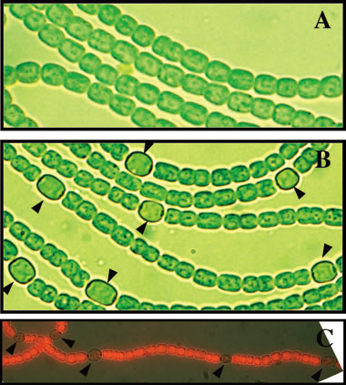
Background
Anabaena PCC7120: Heterocyst differentiation after N deprivation
CO₂
+NO₃⁻, NH₄⁺,urea ...
Vegetative cells
COOH⁻
Combined-nitrogen deprivation
CO₂
Vegetative cells
N₂
+
COOH⁻
N₂
Heterocysts
(Zhang et al, 2006)
NH₄⁺
Notes:
Filamentous photoautotrophic cyanobacteria
Combined nitrogen

Slide 2
Biological Questions
Oxo-glutarate
Molecular 2-OG
1. Measure 2-OG in intact cells
2. 2-OG distribution in stationary state, in pattern or stochastic?
N starvation
3. 2-OG distribution dynamics during cell differentiation, accumulate in all the cells the same speed or mostly in pro-heterocyst?
Heterocyst
Heterocyst

Slide 3
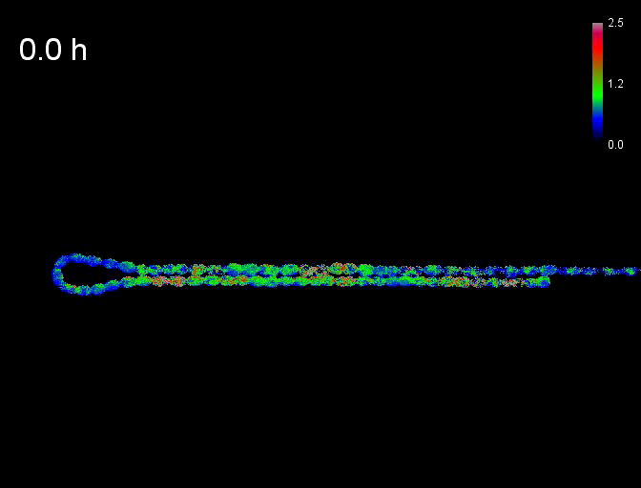
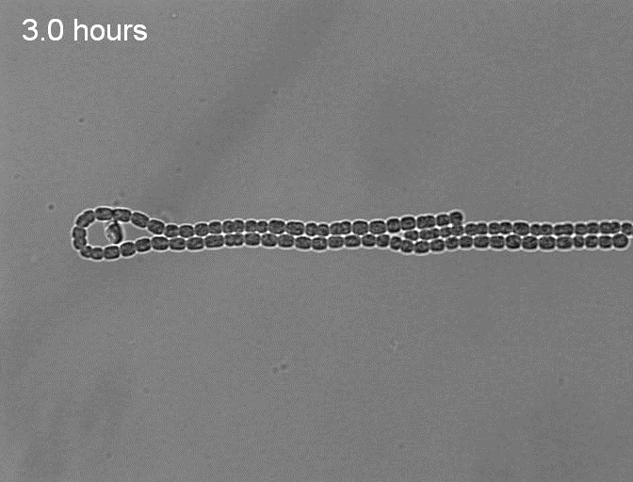
Time-lapse imaging system for Anabaena
Time lapse of FRET ratio on filaments

Slide 4
Analysis Concerned :
Automatically generate ROI (Region Of Interest) and extract data from ROI
Automatically generate ROI in order correlate with position on filaments
Track or backtrack cells during cell development
Question to be answered:
2-OG level in cells in population
2-OG Patterns on the filament
Locate pro-heterocyst and find correlations of Heterocyst pattern and 2-OG pattern

Slide 5
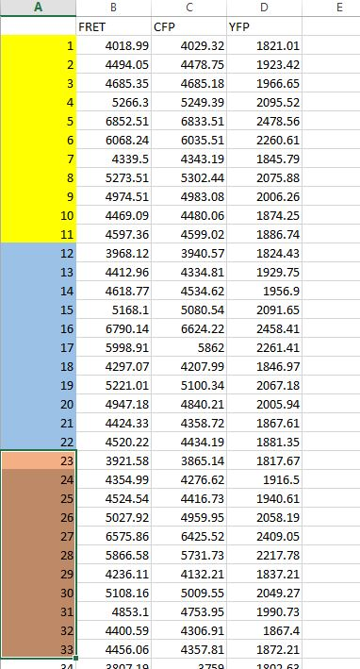
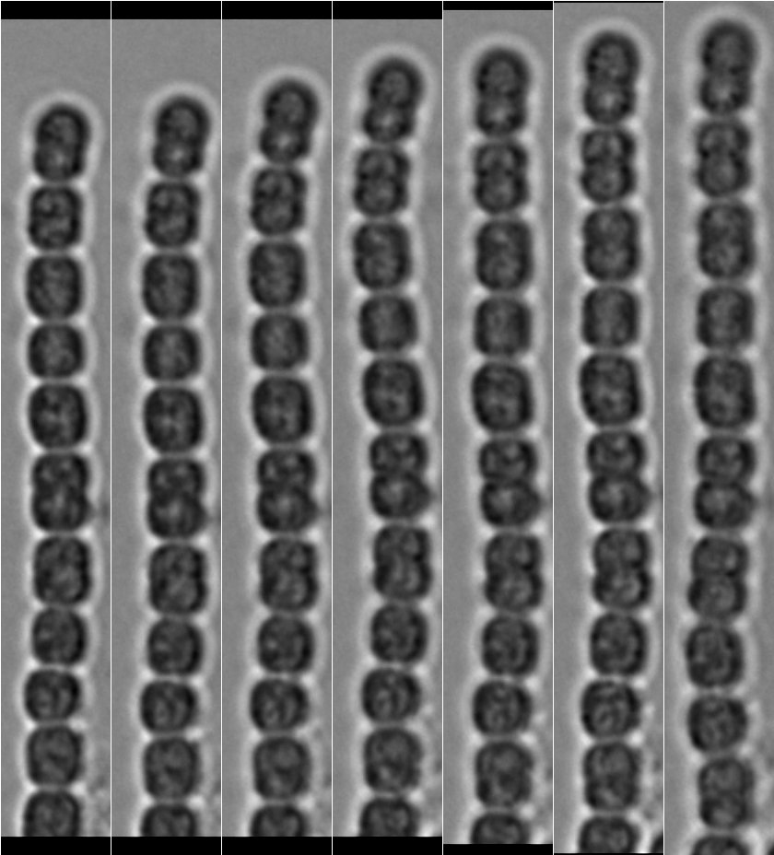
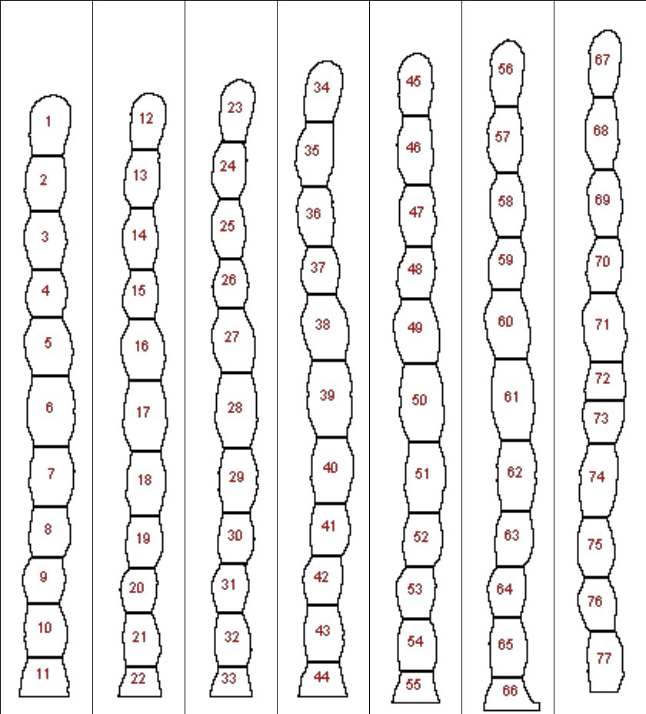
What I tried…
To measure 2-OG level in population

Slide 6
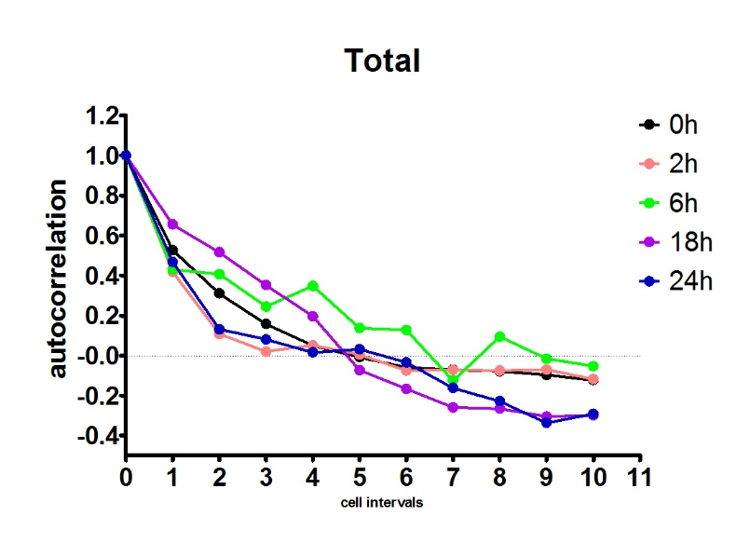
To find patterns
Autocorrelation of 2-OG level on filaments

